Slide 1

Introduction of API Testing
Introduction to API Testing

Slide 2

Agenda
Introduction to API and its types?
Introduction to API Testing
Introduction to Postman? How to install Postman?
Create Workspace and Collection and Add Request.
Create (HTTP Methods ) GET, POST, PUT ,PATCH and DELETE Requests.
Variables and its types
How to write Test Case and Verify Test Case.
Assertions(Status Code, Response Time , Response Body, Response Header)
Introduction to JSON.
How to Validate JSON Schema in POSTMAN.
API Chaining
How to Upload file in POSTMAN.
What is Mocking and How to Create A Mock Server in Postman.
What is API Monitoring.
Authentication and it's Types
API Documentation
Newman HTML Report
Reference Website for API Testing.
Interview Questions

Slide 3
Introduction of API

Slide 4
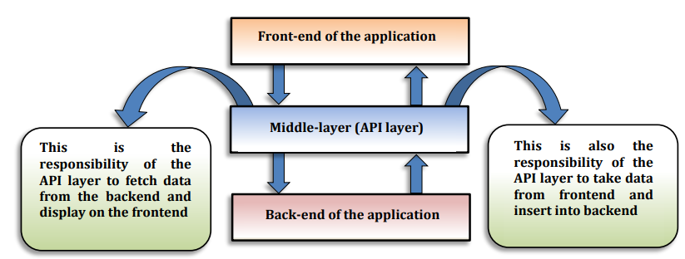
Introduction to API
API stands for the Application Programming Interface. It’s kind of intermediary that allows two applications to talk to each other.
APIs provide a set of rules, protocols, and tools that developers can use to access the functionality and data of another software system, service, or platform .
APIs helps in structuring the requests and responses, making it possible for developers to integrate various services and functionalities into their own applications without having to build everything from scratch.

Slide 5
Types of API

Slide 6

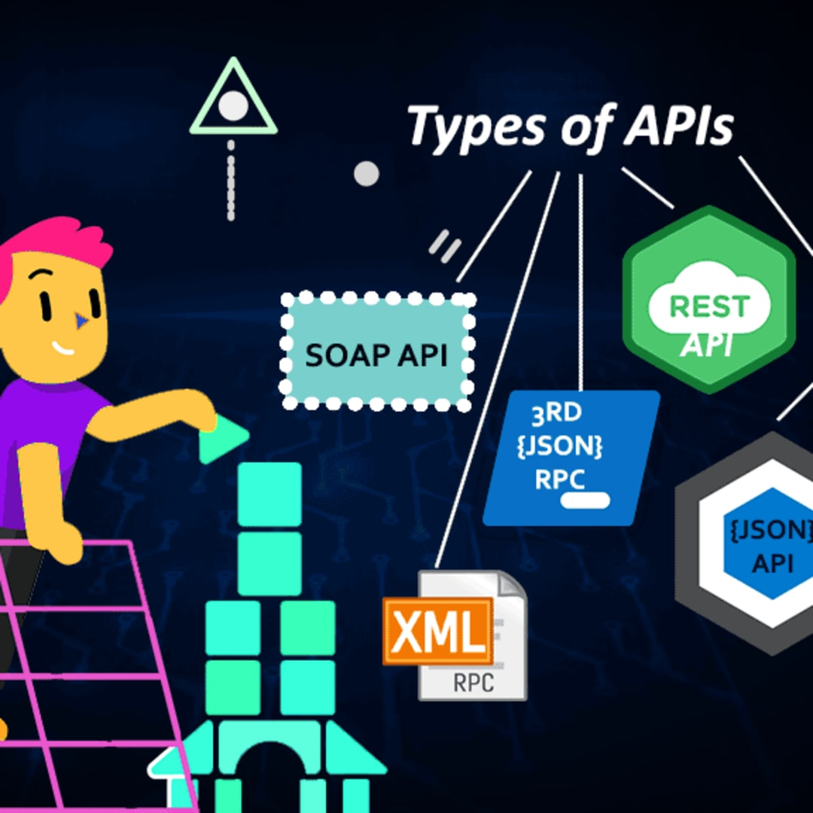
Types of API
SOAP API (Support XML Format)
REST API (Support JSON Format)
SOAP stands for Simple Object Access Protocol .
A SOAP API is an interface that allows applications to communicate with each other using SOAP protocol.
Soap is used for sending message between applications over various protocols , including HTTP, SMTP(Simple Mail Transfer Protocol), and more.
REST API stands for Representational State Transfer the resources are identified by unique URLs.
REST uses standard HTTP methods(GET , POST ,PUT ,DELETE , etc.) to perform actions on resources.
REST APIs are relatively simple to understand and use.

Slide 7

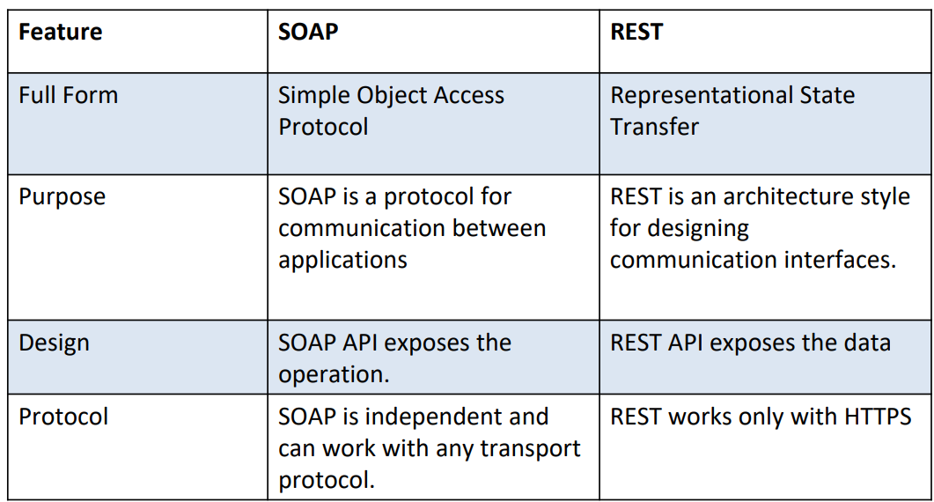
Difference Between SOAP and REST

Slide 8

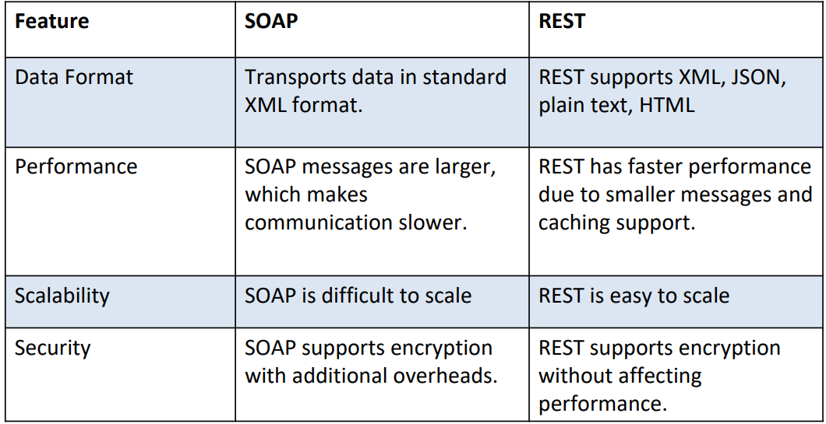
Difference Between SOAP and REST

Slide 9
Introduction To API Testing

Slide 10
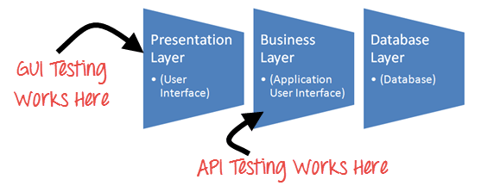
Introduction to API Testing
It is a software that validates the Application Programming Interfaces(APIs).
● The main use of API testing is to check for functionality, reliability, performance, and security of the programming interfaces.
● Instead of standard inputs and outputs, a software can be used to send calls to the API, get output, and note down the system’s response.
● A model-driven development approach is also used to map out how the software system should work before the actual coding begins

Slide 11
Introduction to POSTMAN?

Slide 12

Introduction to Postman
Postman is a standalone software testing API (Application Programming Interface) platform to build, test, design, modify, and document APIs.
Postman is one of the most popular software testing tools which is used for API testing.
It has a graphical user interface (GUI) and can be used in platforms like Linux, Windows and Mac.
Postman has the feature of sending and observing the Hypertext Transfer Protocol (HTTP) requests and responses.
It can be used to design, document, verify, create, and change APIs.
It can build multiple HTTP requests − POST, PUT, GET, PATCH and translate them to code.

Slide 13

Postman comes without any licensing cost and is suitable for use for the teams with any capacity. Postman can be used very easily by just downloading it and logging into your own account after installation on the device. Postman has big community support. Postman is capable of building multiple API calls like SOAP, REST , and HTTP.
Why Postman is so popular?

Slide 14
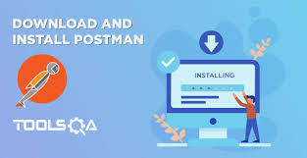
Setting up the testing environment for API testing involves preparing the necessary tools, configurations, and resources to facilitate efficient testing. Postman: Used to create and send API requests, manage collections of requests, and automate testing
Tools and Environment Setup

Slide 15
Step 1) Download Postman Go to https://www.postman.com/downloads/ and choose your desired platform among Mac, Windows or Linux. Click Download. Step 2) Click on Run Your download is in progress message should now display on the Apps page. Once the Postman download is completed, click on Run. Step 3) Postman Installation Start Wait for some time to Complete the Installation of Postman. Step 4) Signup for Postman Account In the next window, Signup for a Postman Account. NOTE: There are two ways to sign up for a Postman account. One is to create an own Postman account, and the other is to use a Google account. Though Postman allows users to use the tool without logging in, signing up ensures that your collection is saved and can be accessed for later use. .
How to Download and Install POSTMAN

Slide 16
Step 5) Click on Save My Preferences Select the workspace tools you need and click Save My Preferences. Step 6) Congratulation! You will see the Startup Screen.
How to Download and Install POSTMAN

Slide 17
HTTP Methods

Slide 18
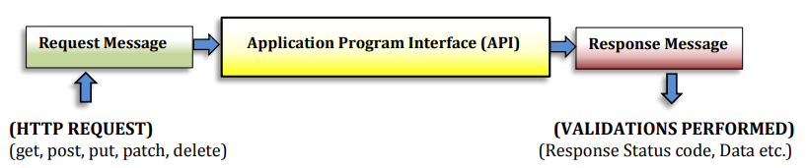
HTTP is an application layer protocol designed within the framework of the Internet protocol suite.
HTTP Methods
HTTP stands for Hyper Text Transfer Protocol. World Wide Web (WWW) is all about communication between web clients (A web client is a client-side application used for connecting to a web server over HTTP) and servers. Communication between client computers and web servers is done by sending HTTP Requests and receiving HTTP Responses.
Communication between clients and servers is done by requests and responses:
A client (a browser) sends an HTTP request to the web
An web server receives the request
The server runs an application to process the request
The server returns an HTTP response (output) to the browser
The client (the browser) receives the response

Slide 19
The most commonly used HTTP methods are: GET:- The GET method is used to retrieve data on a server. GET requests typically do not include a request body, as the client is not attempting to create or update data. POST :- The POST method is used to create new resources. POST requests typically include a request body. PUT :- The PUT method is used to replace an existing resource with an updated version. This method works by replacing the entire resource. with the data that is included in the request’s body. Patch :- The PATCH method is used to update an existing resource. It is similar to PUT, except that PATCH enables clients to update specific properties on a resource—without overwriting the others. Delete :- The DELETE method is used to remove data from a database.
HTTP Methods

Slide 20
Variable and it’s Types

Slide 21
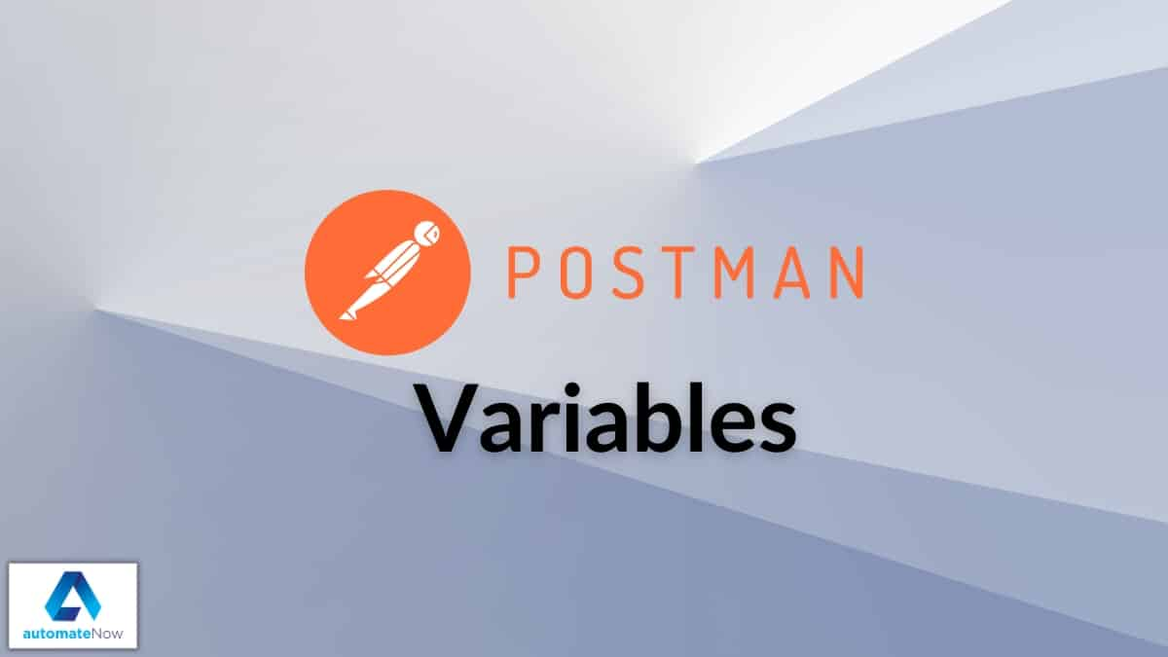
Variables symbolize the data representation and let us access a value without manually entering it wherever we need it. We can define variables as key-value pairs in Postman. The key defines the variable name that allows us to access its value directly using this key Types of Variables:- Global variables: These are accessible throughout the workspace and have the broadest scope in Postman. They can be used anywhere among multiple requests and collections within the workspace. Collection variables: These variables are accessible only inside a certain collection. They are available across all the requests within a collection. Also, they don’t change based on the selected environment. Environment variables: These variables let us scope the work as per the different environments. They change along with the change in the environment we are working on like local environment, staging or the production environment.
Variable and it’s Types

Slide 22
Variables and it’s Types
Data variables: These types of variables are external and define the data sets while running collections with the Collection Runner. We can extract this from a CSV or a JSON file. They have current values that don’t persist after a request or collection executes.
Local variables: These variables are also known as temporary variables that are only accessible through a request script. They have scope only till the current request or collection. Once the execution completes, they are no longer available.

Slide 23
Defining Variables in Scripts:-
All of these methods take in (variable_key, variable_value) as input:
pm.globals: This method is used for defining the global variables in a request script, e.g., pm.globals.set(“variable_key”, “variable_value”);
pm.collectionVariables: We can define a variable with scope as ‘collection’ with this method, e.g., pm.collectionVariables.set(“variable_key”, “variable_value”);
pm.environment: This can be used for defining an environment variable with scope as current environment, e.g., pm.environment.set(“variable_key”, “variable_value”);
pm.variables: This defines the local variable with local/temporary scope, e.g., pm.variables.set(“variable_key”, “variable_value”);

Slide 24
Introduction to JSON

Slide 25

JSON stands for JavaScript Object Notation. JSON is a lightweight format for storing and transporting data. JSON is often used when data is sent from a server to a web page. JSON is not a programming language. It is a common and open standard format for storing and exchanging data. JSON is language independent. Rules – JSON: 1. Data is in key/value pairs: Key/value pair consists of a key in double quotes followed by a colon, followed by a value. In JSON, keys must be strings in double quotes but values can be of any type such as a string, a number, an object (JSON object), an array, a Boolean, null. Example: "name": "John"
Introduction to JSON

Slide 26
2. Data is separated by commas: Data is separated by a comma in JSON. Example: "name": "John", "age": 10, "country": "USA“ 3. Object starts and ends with curly braces {} : JSON Objects are surrounded by Curly braces {}. Example : { "name": "John", "age": 10, "country": "USA" } 4. Arrays starts and ends with square brackets [] : Square brackets hold arrays.
Introduction to JSON

Slide 27
JSON Schema Validation
JSON Schema is a powerful tool for validating JSON data. It provides a standardized format for defining the structure and content of JSON data, which allows developers to ensure that data they receive or generate conforms to certain rules and constraints.
JSON Schema is the use of validation keywords, which are used to define these rules and constraints.
It describes the existing data format with clear, human and machine-readable documentation for complete structural validation, useful for automated testing and validating client submitted data.

Slide 28
JSON Schema Validation
Why is JSON Schema Validation required?
JSON Schema Validation is required because:
We monitor API responses and ensure that the format that we are getting is same as the expected one.
We get alert whenever there is any breaking change in JSON response.
We use JSON Schema to construct a model of API response and it makes easier to validate that API is returning the valid data.

Slide 29
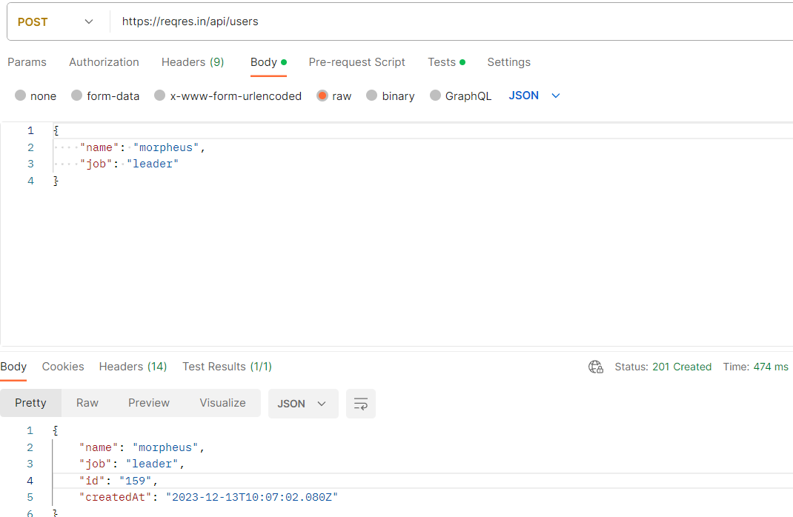
Schema Validation
Request Body
Response Body

Slide 30
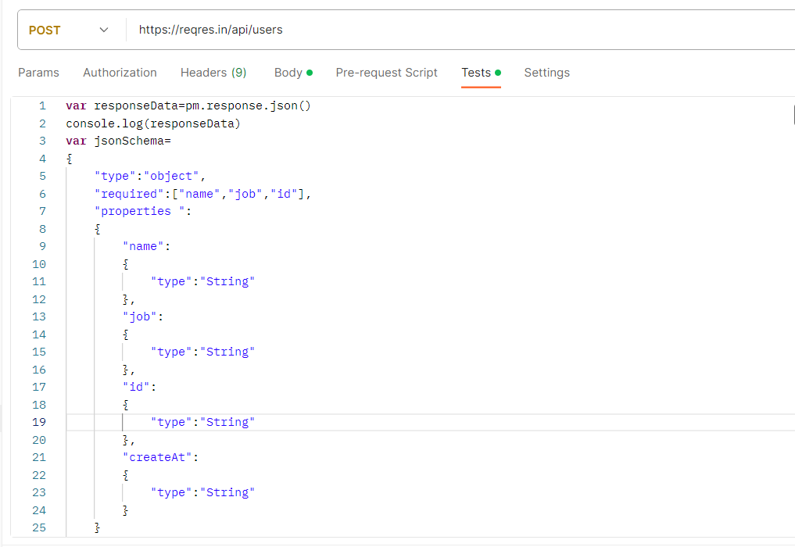
Schema Validation
Verify Response Body

Slide 31
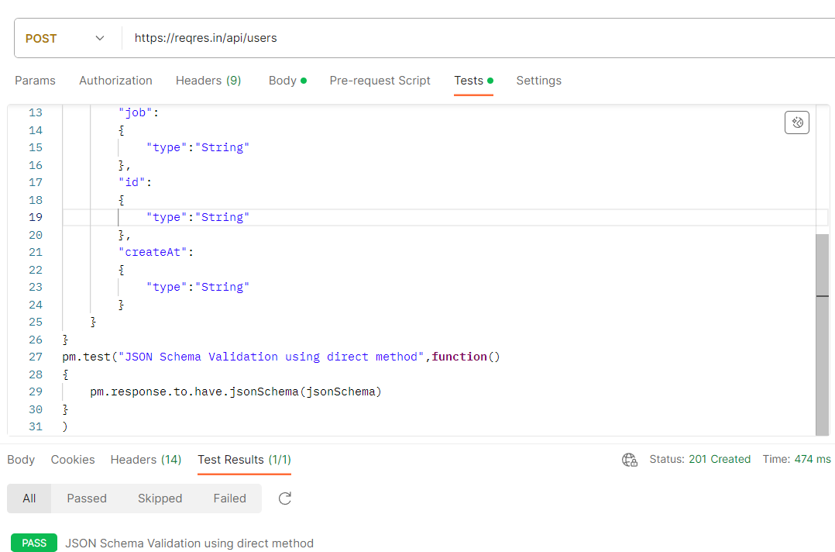
Schema Validation

Slide 32
Requried Keyword:- The required Keyword is used to specify which properties are required in an objects.
It takes an array of strings, where each string is the name of a required property.
Type Keyword:- The type keyword is used to specify the type of a JSON value. It can take string or an array od Strings , where each string is a valid JSON Type.
Properties Keyword :- The properties keyword is used to define a schema for each property of an object. It takes an object where the keys are the property names and the values are schemas that describe the properties.
Validation Keywords

Slide 33
API Chaining

Slide 34
The API chaining method is to create a sequence of API calls where the output of one API request is used as the input for the next.
API Chaining

Slide 35
What is Mocking ??

Slide 36
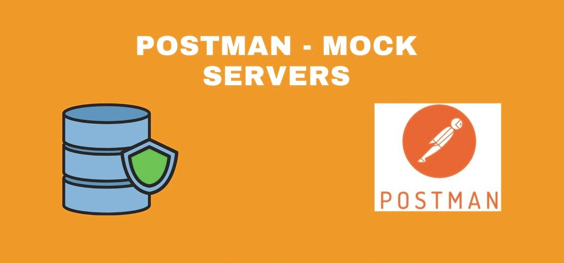
What is Mock Server?
A mock server is not a real server and it is created to simulate and function as a real server to verify APIs and their responses.
These are commonly used if certain responses need to be verified but are not available on the web servers due to security concerns on the actual server.
The process of creating the mock server and perform the activity is called Mocking.
Mock Server is created for the reasons listed below −
A Mock Server is created if the APIs to be used in Production are still in development.
A Mock Server is used if we want to avoid sending requests on real time data.

Slide 37
How to Upload File in POSTMAN.

Slide 38
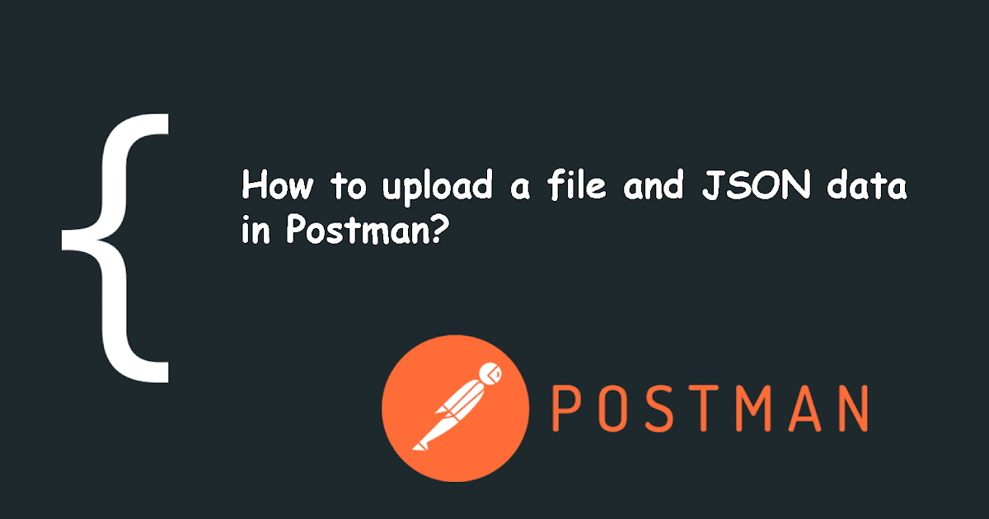
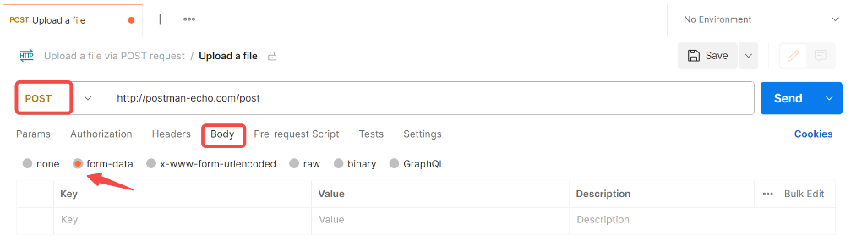
How to Upload file in POSTMAN
Step 1. Select the POST request in Postman.
Step 2. Choose the "from-data"
Select the "Body" tab and choose "form-data" as the type of body

Slide 39
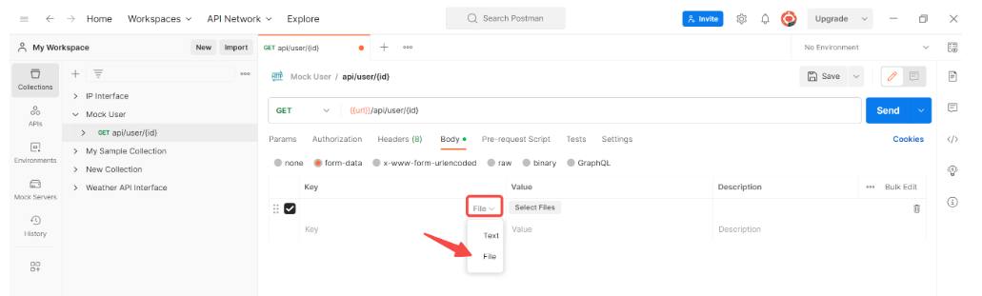
How to Upload file in POSTMAN
Step 3. Click on "Files" Set the Value Type
Select the file or text you want to upload. Here we set the "File" to upload.

Slide 40
How to Create A Mock Server in Postman.

Slide 41
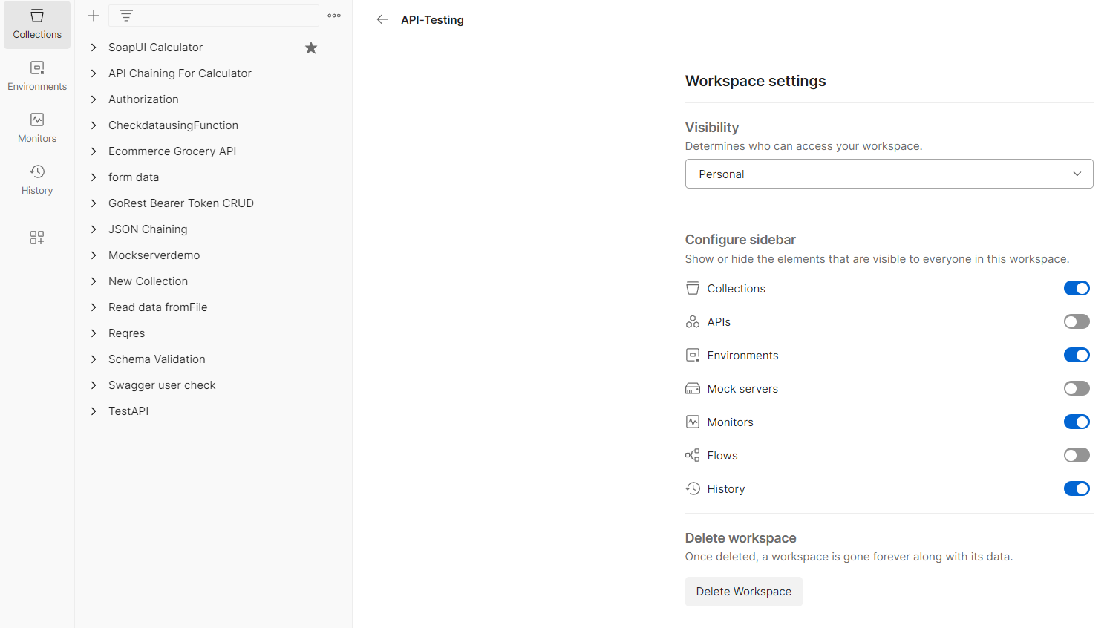
Steps to Create a Mock Server
Step 1. Select Collections in the sidebar and Turn on Mock Servers.
Step 1

Slide 42
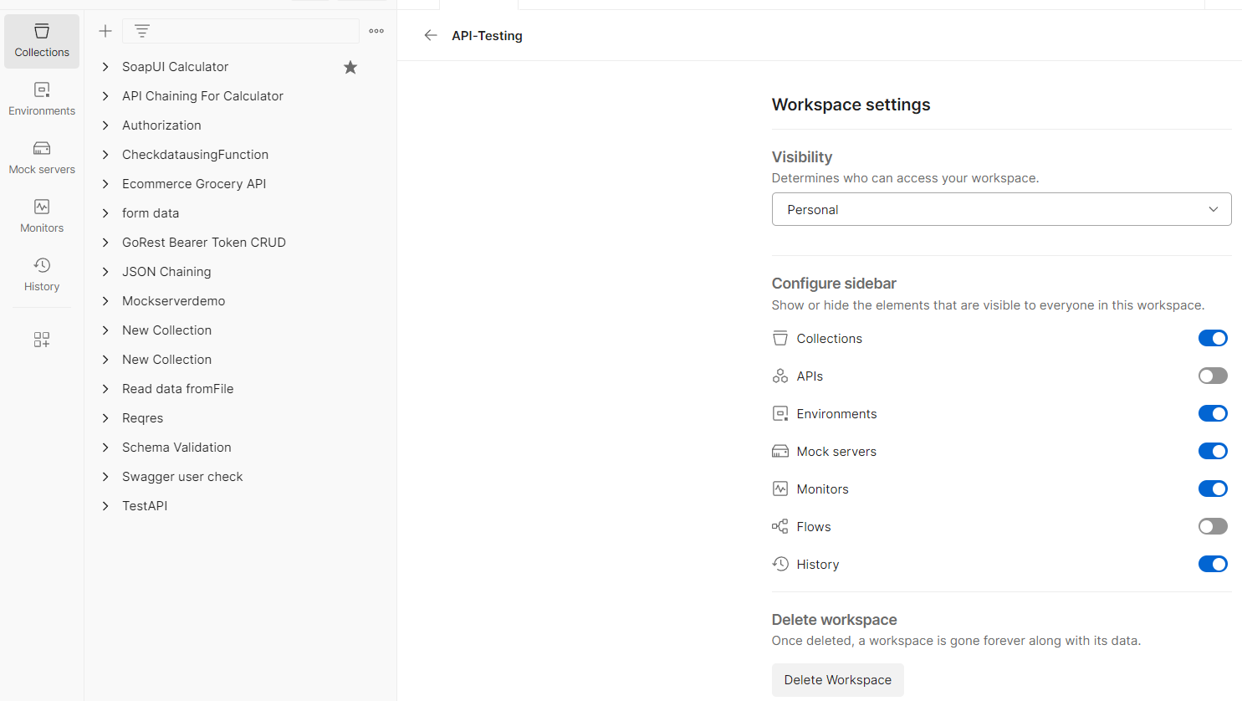
Steps to Create a Mock Server
Step 2. AfterTurn on Mock Servers option on left side of Sidebar The Mock Servers Option is Visible .
Step 2

Slide 43
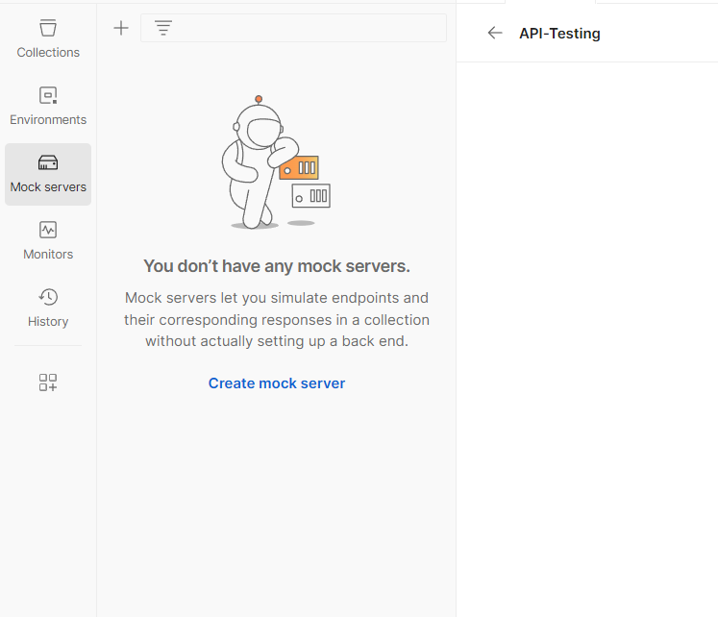
Steps to Create a Mock Server
Step 2. Select Mock Servers option on left side of Sidebar and then Click on Create Mock Server
Step 3

Slide 44
Steps to Create a Mock Server
Step 2. AfterTurn on Mock Servers option on left side of Sidebar The Mock Servers Option is Visible .
Step 2

Slide 45
Steps to Create a Mock Server
Step 2. AfterTurn on Mock Servers option on left side of Sidebar The Mock Servers Option is Visible .
Step 2

Slide 46
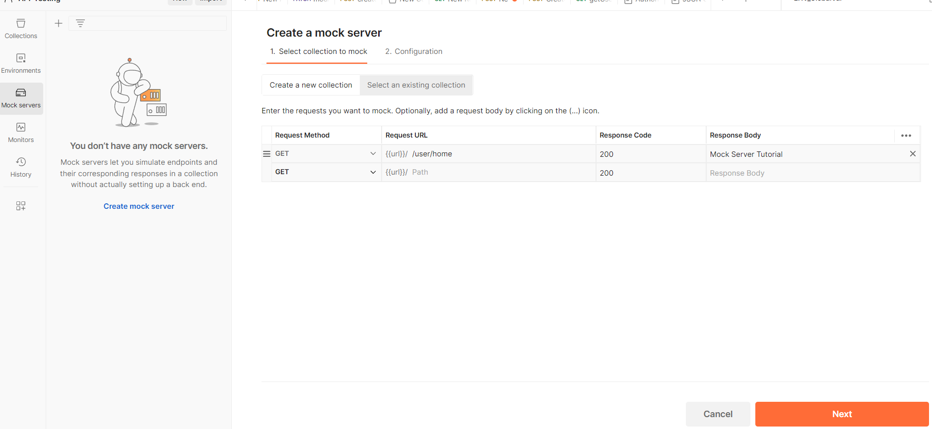
Steps to Create a Mock Server
Step 3: Select GET from the Method dropdown, enter a Request Path as /user/home, Response Code as 200, and a Response Body. Then, click on Next..
Step 3

Slide 47
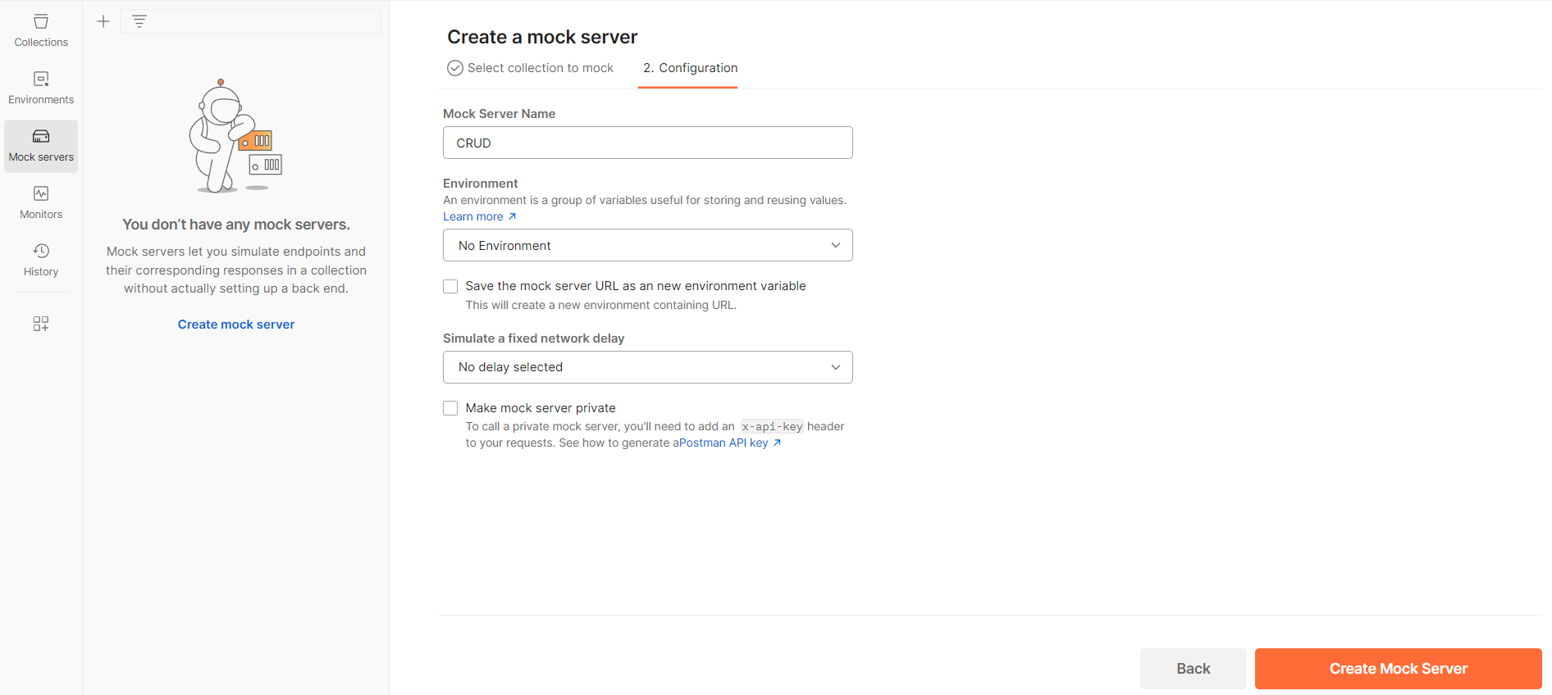
Steps to Create a Mock Server
Step 4: Enter a Mock Server name and click on the Create Mock Server button.

Slide 48
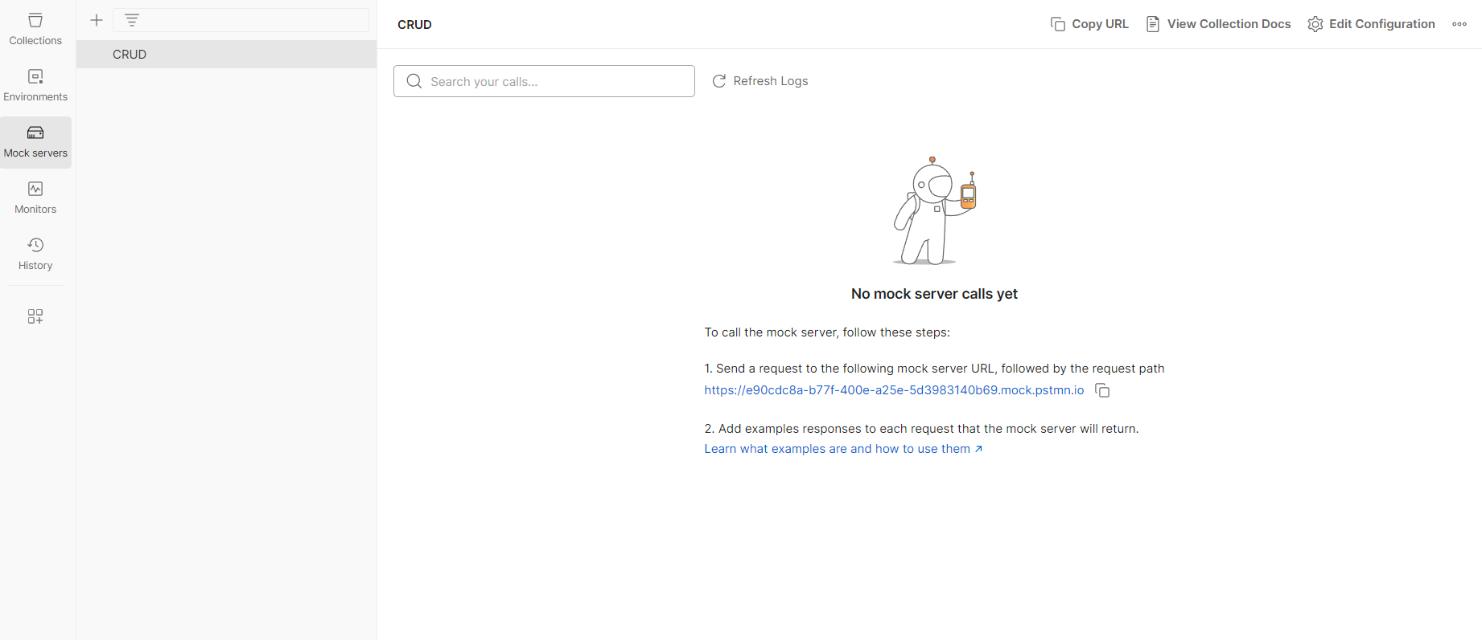
Steps to Create a Mock Server
Step 5 :- The Mock Server gets created along with the Mock URL. The Copy Mock URL button is used to copy the Mock link. Click on the Close button to proceed.

Slide 49
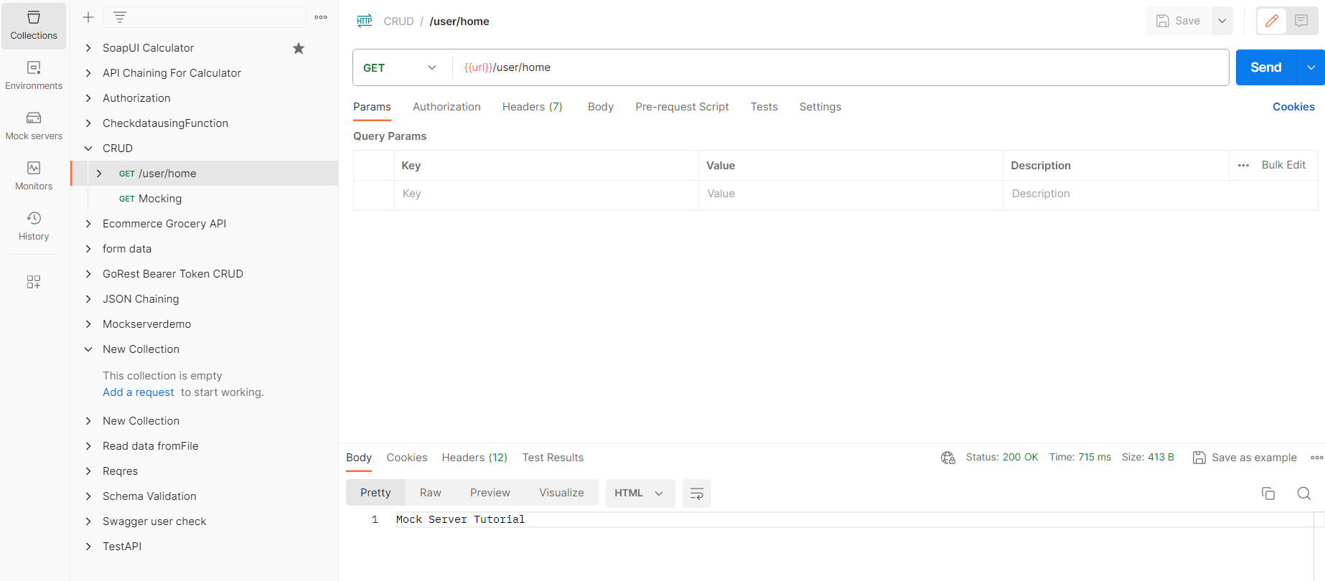
Steps to Create a Mock Server
Step 6 :-Click on Collections and check Mock Server is Created /user/home.

Slide 50
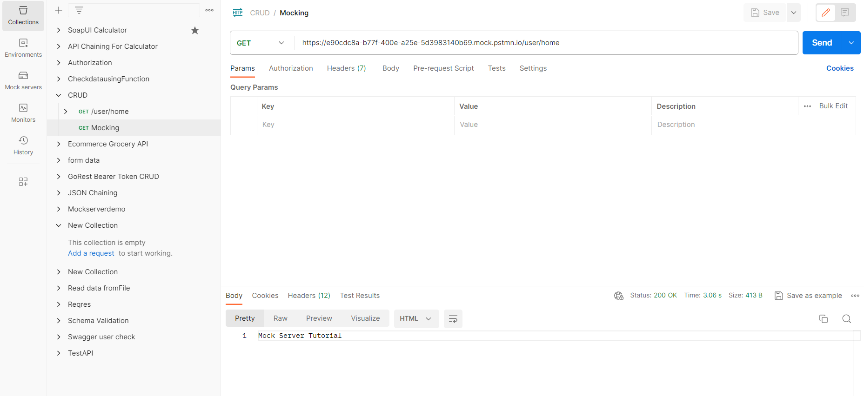
Steps to Create a Mock Server
Step 7 :-Click on Collections and check Mock Server is Created with Mock URL with/user/home .

Slide 51
Steps to Create a Mock Server
https://www.tldevtech.com/json-example/

Slide 52
Authorization and its types

Slide 53

Authentication
Authentication is a process of presenting your credentials like username, password or another secret key to the system and the system to validate your credentials or you.
In the API terms Authentication is used to protect the content over web mean only a valid user with valid credentials can access that API endpoint.
These credentials tell the system about who you are. Which enables the system to ensures and confirms a user’s identity
Here system can be anything, it can be a computer, phone, bank or any physical office premises.

Slide 54
Types of Authentication
Authentication supported by APIs in POSTMAN:-
No Auth
Bearer Token
Basic Auth
Digest Auth
OAuth 1.0
NOTE: - Go the Authorization Tab and Click on TYPE to Select the Authorization that you want.

Slide 55
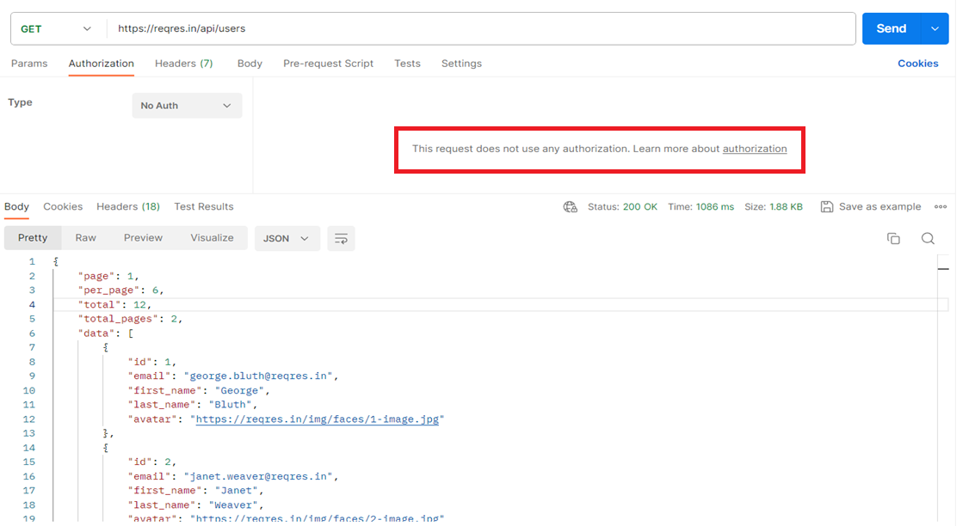
Types of Authentication
No Auth :- No Auth means that any HTTP or HTTPS request for GET, PUT or Post extra with no authentication required. They are open request with no privacy and open content.

Slide 56
Basic Authentication
Basic Auth :-Basic access Authentication is a method for an HTTP user agent (e.g. a web browser) to provide a username and password when making a request.
String is encoded with Base64.
In the example, we will use the postman internal URL to create Basic Auth example –https://postman-echo.com/basic-auth.
Username postman and Password password.

Slide 57
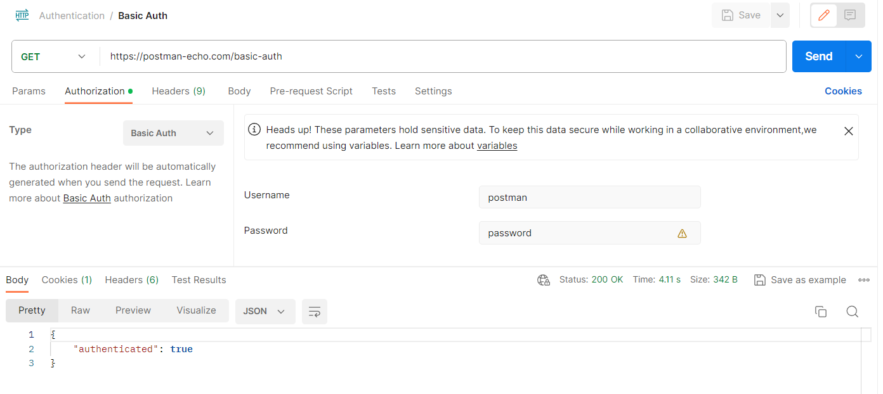
Basic Authentication

Slide 58
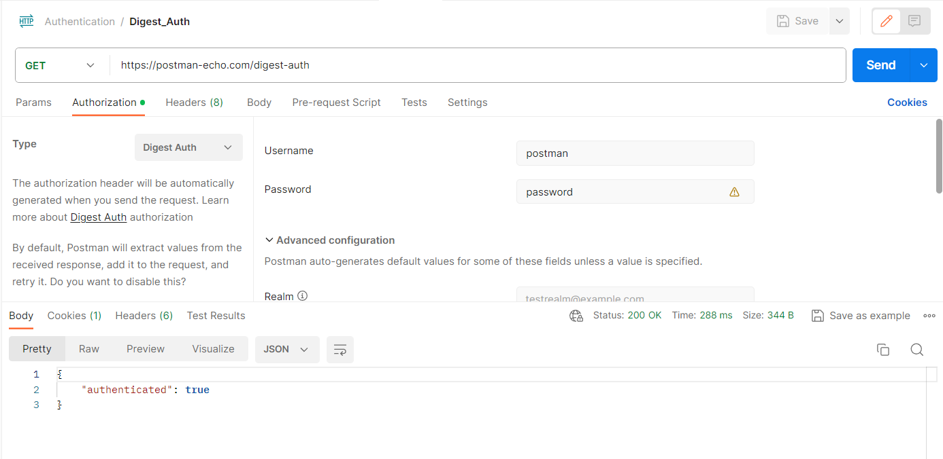
Digest Authentication
Digest Authentication is similar to Basic Authentication. The only difference is that when you use digest Authentication, the credentials are sent in an encrypted form.
Authentication is performed by transmitting the password in an ENCRYPTED form.

Slide 59
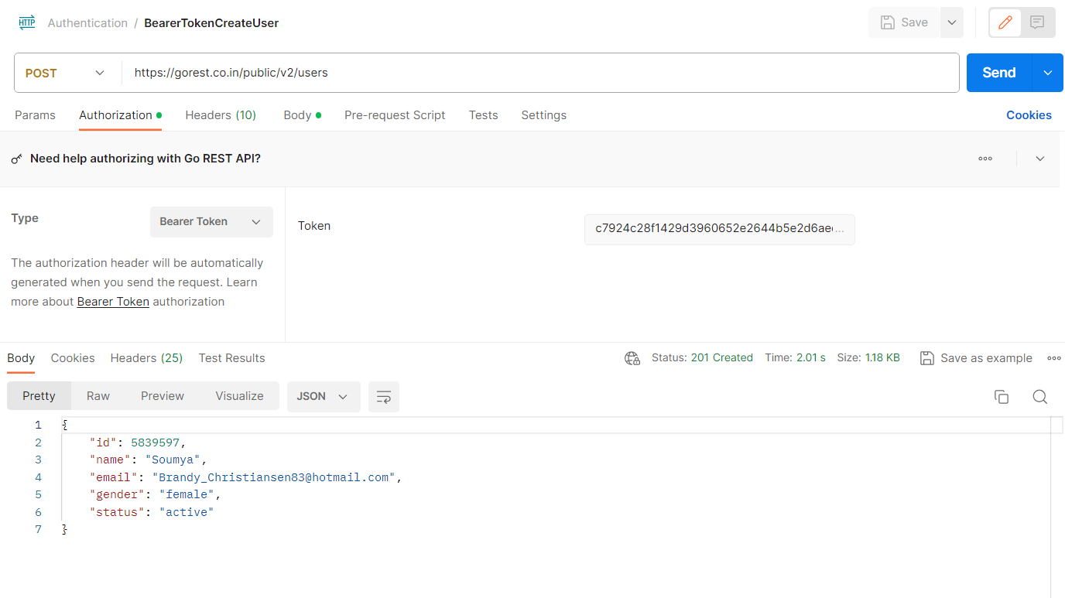
Bearer Token Authentication
A Bearer token is a type of token used for authentication and authorization and is used in web applications and APIs to hold user credentials and indicate authorization for requests and access.
For Using the Bearer Token Authorization we need a Access Token.

Slide 60
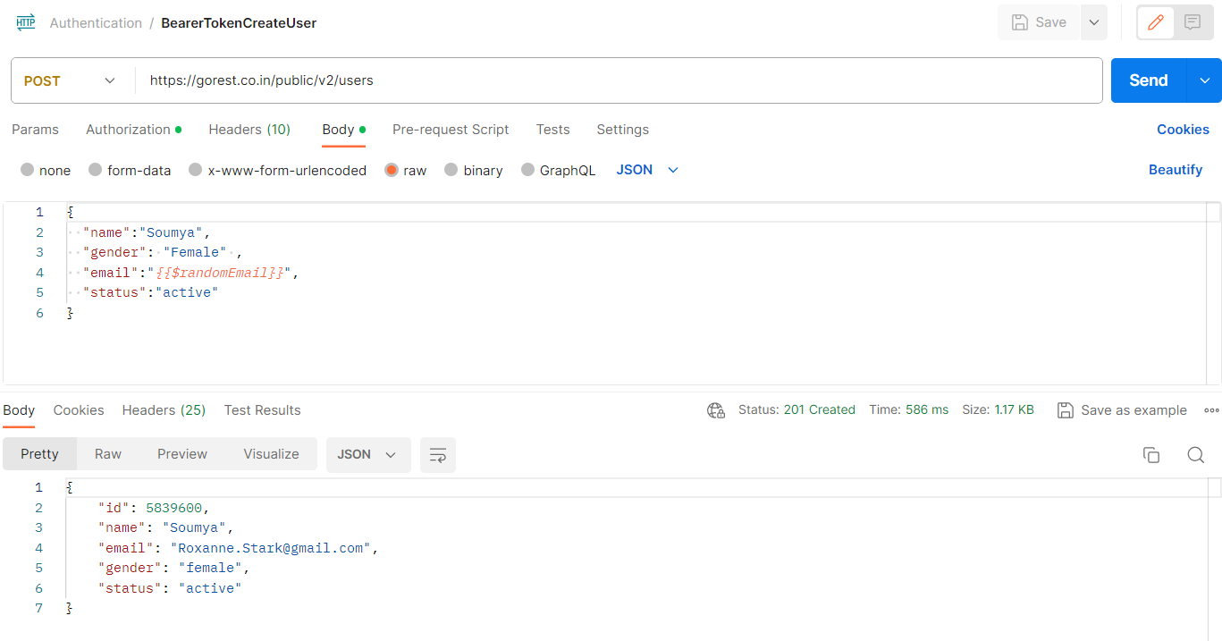
Bearer Token Authentication
Website :- https://gorest.co.in/
POST :- https://gorest.co.in/public/v2/users

Slide 61
Steps to Get Token For Bearer Token
Step 1:- Go the https://gorest.co.in/
Step 2:- Click on Get your access token
Step 3:- Need to login with your social account via Github, Google and Microsoft for Token.
Step 4:-After Successfully Login You got a Access Token .
Step 5:- Copy the Access Token and Paste in Authorization Tab in Token Field.

Slide 62
OAuth 1.0:-
OAuth 1.0 :-
They are the way for Internet users to grant websites or applications access to their information on other websites but without giving them the passwords.
When you perform the OAuth most of the time you have to get the Access token from the website after submitting the details like Consumer key etc.
To make OAuth 1.0 request you need to pass the Consumer key, Consumer Secret and Access Token, Token Secret.

Slide 63
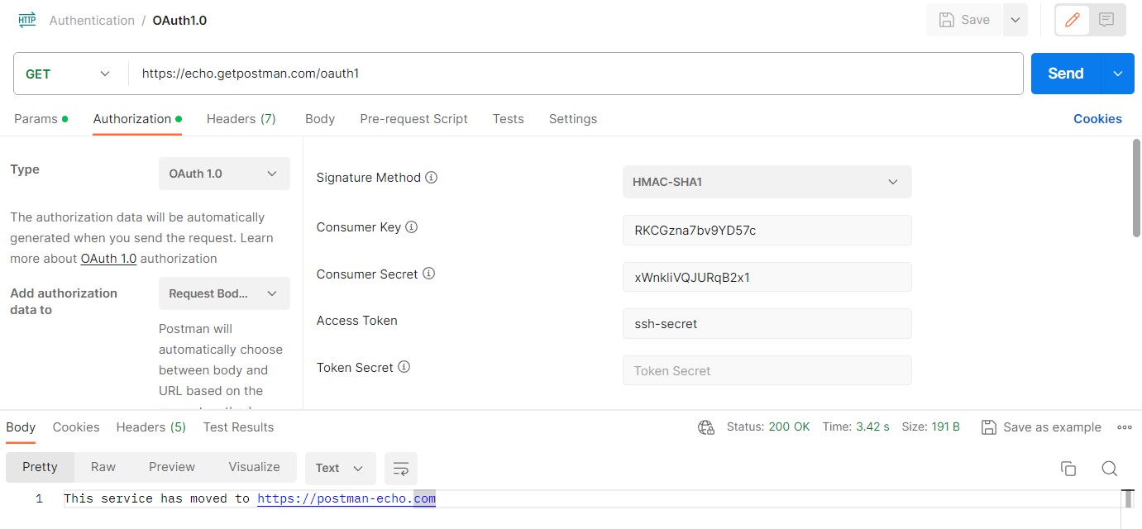
OAuth1.0:-
OAuth 1.0 :-

Slide 64
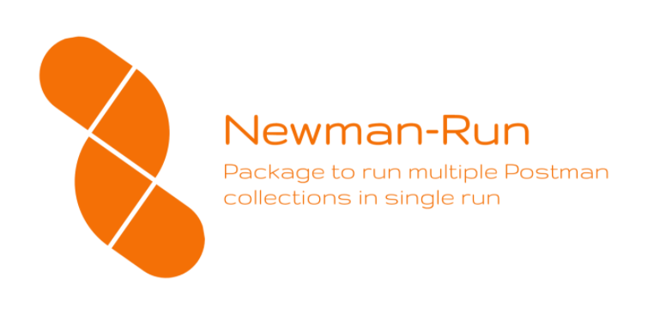
Newman
Newman is a command-line collection runner for Postman. It allows you to effortlessly run and test a Postman collection directly from the command-line.
To run Newman, ensure that you have Node.js >= v16. Install Node.js
From Official Site https://nodejs.org/en/
Steps for Installation:-
1.Install Nodejs.
2.Check version to confirm nodejs install
Write command in command prompt : Node --version.
3.set the path of nodejs in system environment and after path setting check npm on command promt. Npm –version

Slide 65
Newman
4. Install Newman write command on command prompt : npm install -g Newman.
5. Export the collection from postman collection .(Right click on … 3 dot and export it) and save with .JSON file.
6. Now open command prompt where .JSON files are and execute below command :
$ newman run mycollection.json
Reports
Installation html report
$ npm install -g newman-reporter-html
Example : newman run file_name.json -r html
Advanced html report
Newman extra report installation
Npm install -g newman-reporter-htmlextra
Example:*
Newman run file_name.json -r htmlextra

Slide 66
How to Generate HTML Reports Using Newman:-
Installation html report
$ npm install -g newman-reporter-html
Example : newman run file_name.json -r html
Advanced html report
Newman extra report installation
npm install -g newman-reporter-htmlextra
Example:*
Newman run file_name.json -r htmlextra

Slide 67
Reference Website for API Testing.
https://reqres.in/
https://dummy.restapiexample.com/
https://automationexercise.com/
https://gorest.co.in/
https://restful-booker.herokuapp.com/apidoc/index.html
http://www.dneonline.com/
https://petstore.swagger.io/ (Real Time API).

